Slide 1
Superstore sales analysis:
Sales performance across the US based on different variables.
Today 30/05
Name: Le Nguyen Ngoc Yen
Class: D4E50

Slide 2
Table of contents
Step 01
Step 02
Step 03
Defining the question & Collecting the data
Data pre-processing
EDA &
Visualization
Insights & Recommendations
Summary
Step 04
Step 05

Slide 3
Step 1

Slide 4
Defining the question
Sales performance analysis of a business → Giving insights and recommendations
Type of data? Sufficient information for conclusion? Reliable?

Slide 5
Collecting the data
Dataset: Superstore Dataset
Information about sales and profits of Superstore in the US from 2014 to 2017
1 table, 9994 rows and 21 columns
Source: Kaggle - https://www.kaggle.com/datasets/vivek468/superstore-dataset-final
(Kaggle 2022)

Slide 6


Tools used
Data-preprocessing and analysis
Visualization

Slide 7
Step 2

Slide 8
Data pre-processing
Missing values → No
Checking
Overall structure of the dataset
Duplicate values → No
Number of unique values in each column
Changing datatypes
Adjusting
Changing the dataset
Dropping, splitting and adding columns

Slide 9
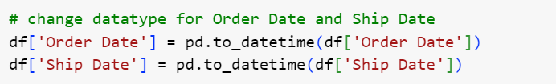

Adjusting
→ wrong datatype: object → datetime
→ irrelevant to the analysis

Slide 10
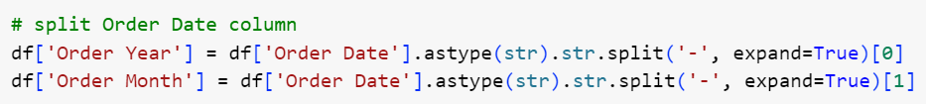
Adjusting
→ splitting Order Date column into Year and Month for sales trend analysis
→ adding the time difference for ship mode analysis

Slide 11
Step 3

Slide 12




Overview
02
04
Customer analysis
Regional analysis
01
03
05
Product analysis
Shipping analysis
Sales trend analysis

Slide 13
Concept definition
01
02
03
Profit margin
Pareto principle
ABC analysis

Slide 14
Profit margin
Profit margin = Profit / Sales (%)
High profit margin → more profit per every dollar of sales
Low profit margin → high costs reduce profit per every dollar of sales
⇒ Company’s profitability and financial health
(Arham 2019)

Slide 15
Pareto principle (80-20)
20% of causes responsible for 80% of outcomes
→ 20% of factors (products, customers,...) contribute to most of the business performance.
⇒ prioritizing, not ignoring
(Tardi 2023)

Slide 16
ABC analysis
best performing (selling) >< worst performing (dead) products of the company
Grade | Quantity | Revenue
A | top 20% | 80%
B | middle 30% | 15%
C | bottom 50% | 5%

Slide 17
Overview
$2.30M
$286.40K
12.47%
Total Sales
Total Profit
Average Profit Margin
9994
793
Total number of Orders
Total number of Customers

Slide 18
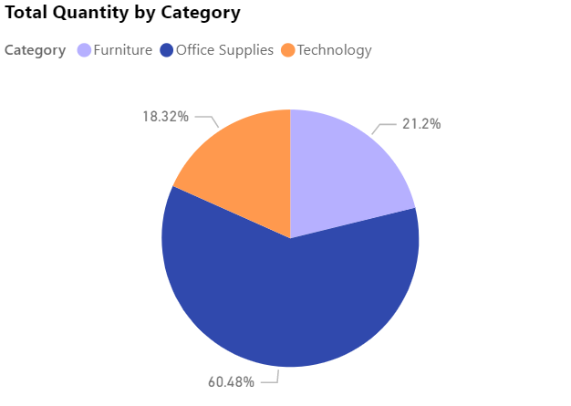
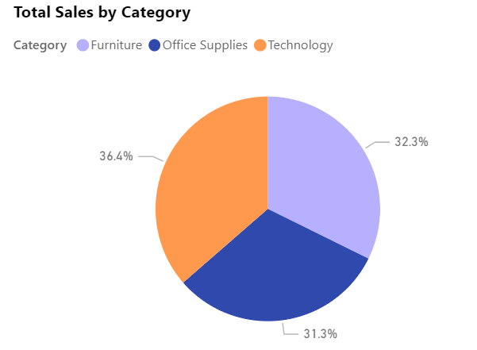
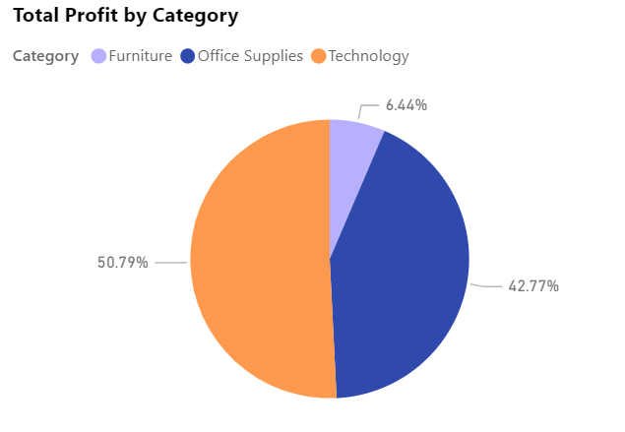
Product analysis

Slide 19
Product analysis
What happened?

Slide 20
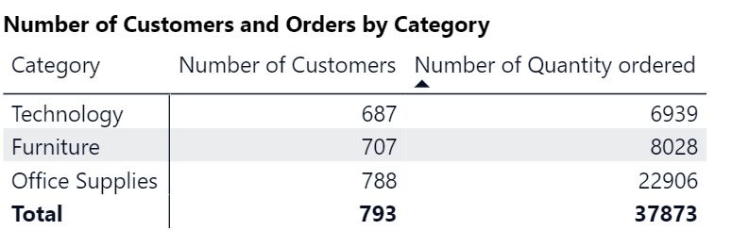
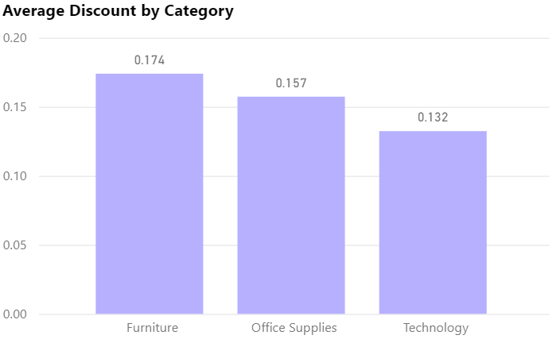
Product analysis
From the data:
+ High average discount rate
+ Low number of quantity sold (?)
Other factors:
+ High cost of production
+ High cost of shipping
+ Low selling price

Slide 21
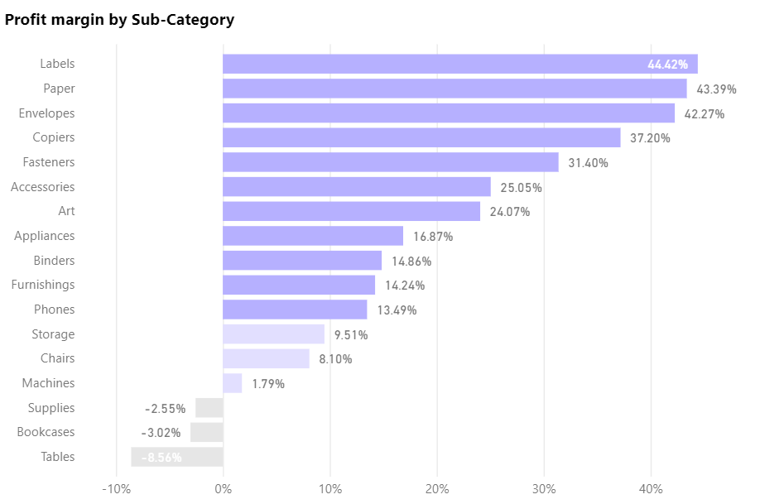
Product analysis
The average profit margin of the store was 12.47% → good profit margin
Loss incurred in supplies, bookcases and tables
Extremely good profit margin for labels, paper and envelopes

Slide 22
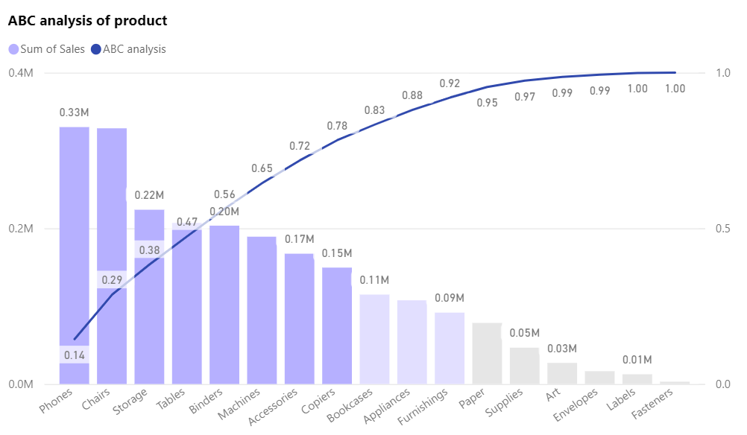
Product analysis
Grade | Quantity | Revenue
A | 23% | 80%
B | 26% | 15%
C | 51% | 5%

Slide 23
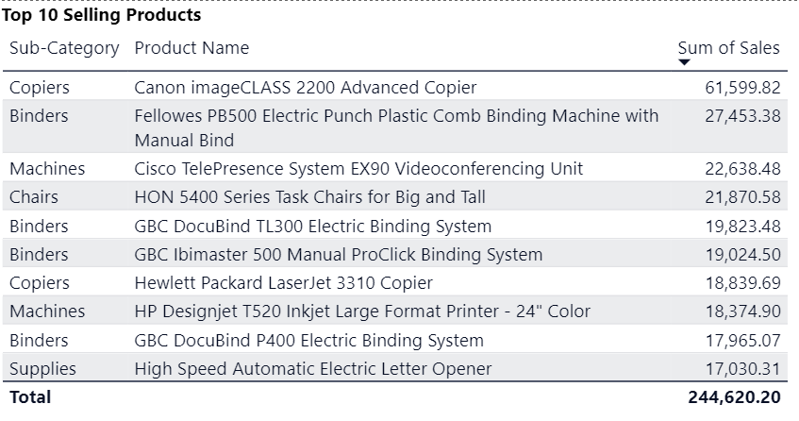
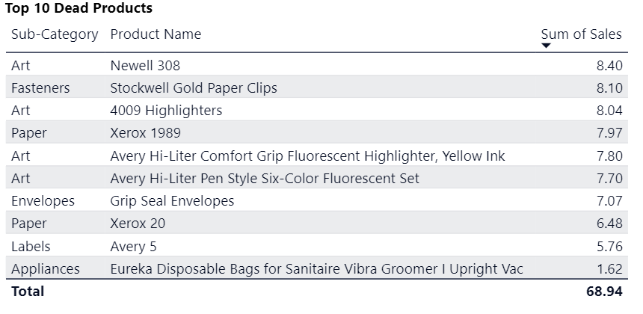
Product analysis

Slide 24
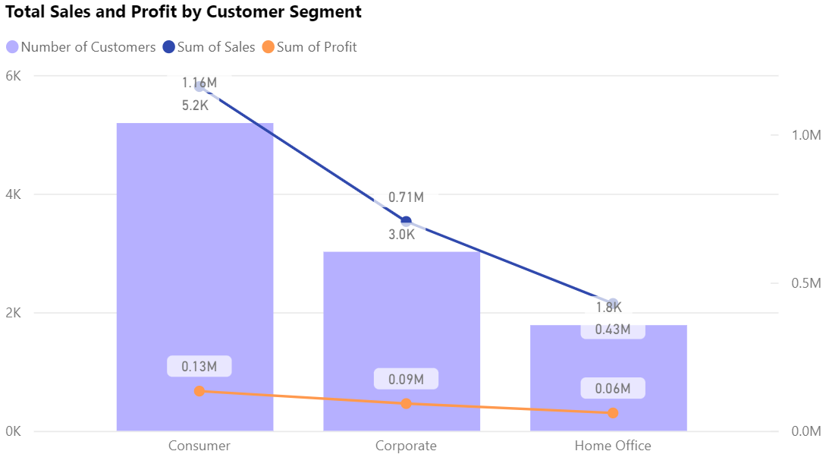
Customer analysis
Consumer segment accounts for the largest percentage of customers, sales and profits

Slide 25
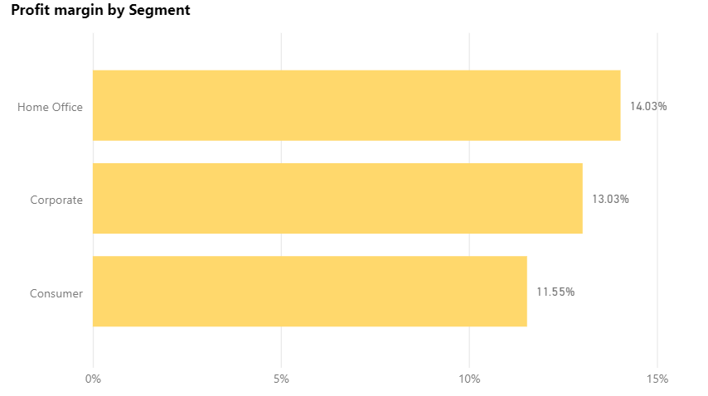
Customer analysis
Profit margins of three segment are relatively similar

Slide 26
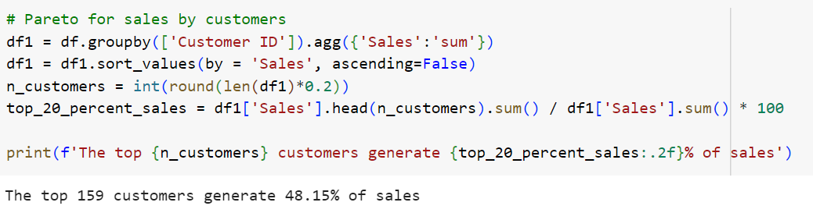
Customer analysis - Pareto

Slide 27
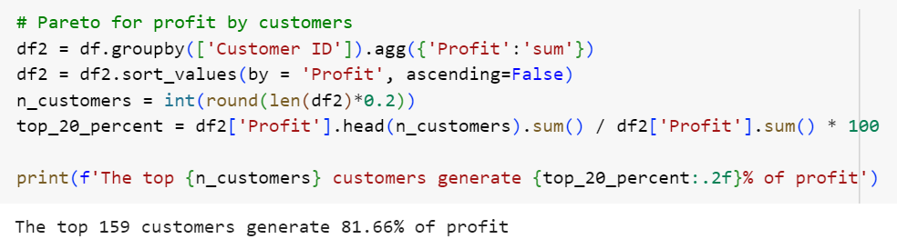
Customer analysis - Pareto

Slide 28
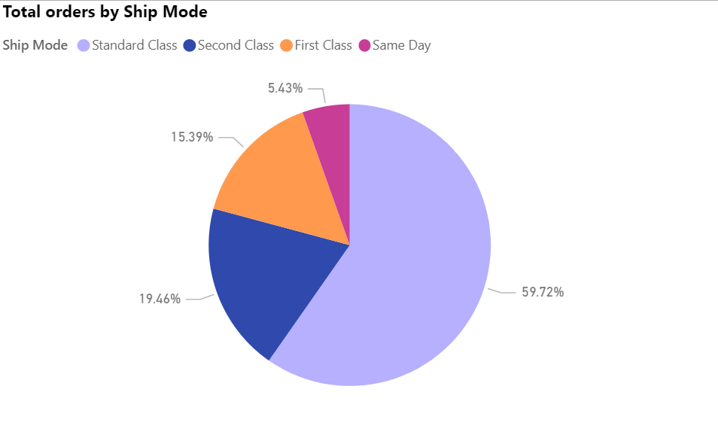
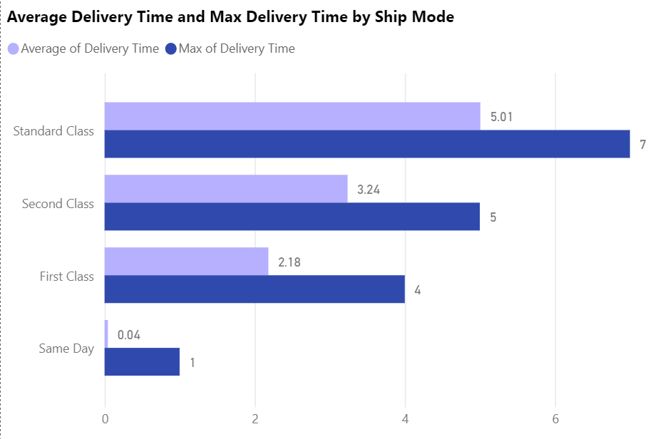
Shipping analysis
Most orders selected Standard Class
The average delivery time for Same Day, First Class, Second Class and Standard Class is 0, 2, 3 and 5 respectively

Slide 29
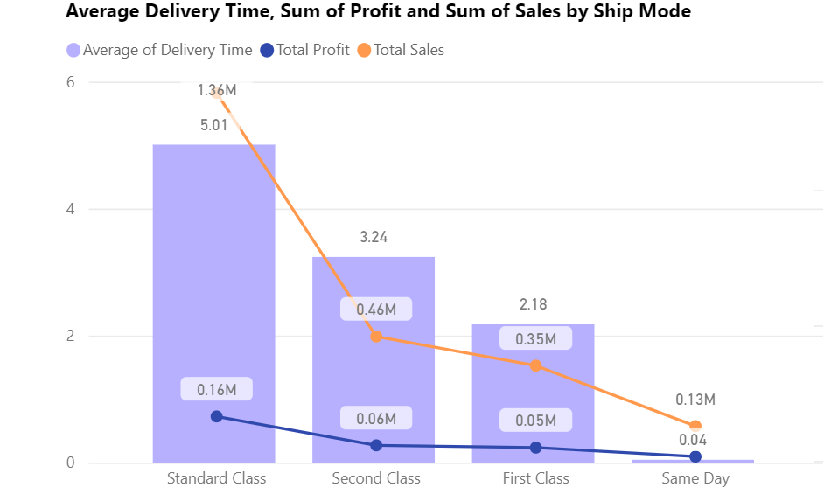
Shipping analysis
Standard Class accounts for the highest sales and profit (~60%)

Slide 30
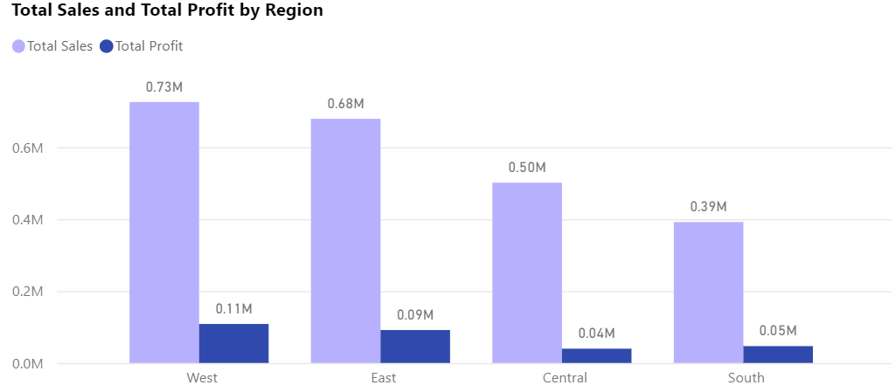
Regional analysis
The West and East of the US account for the most sales and profit

Slide 31
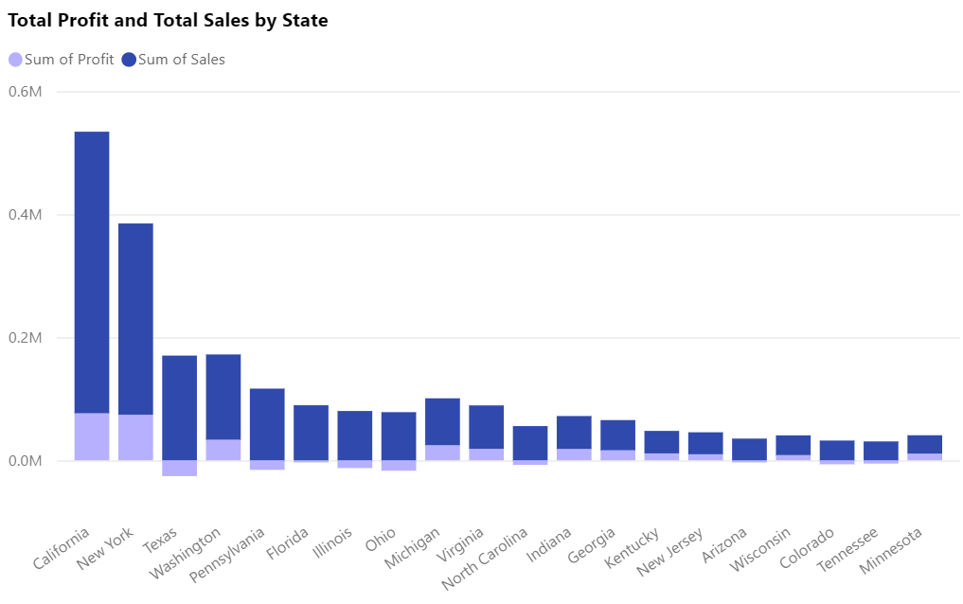
Regional analysis
California and New York account for about 50% of sales and profit in the US
Texas stands in the 3rd place yet on the verge of losing out
About half of top 20 high-sale states incurred loss or gained little profit

Slide 32
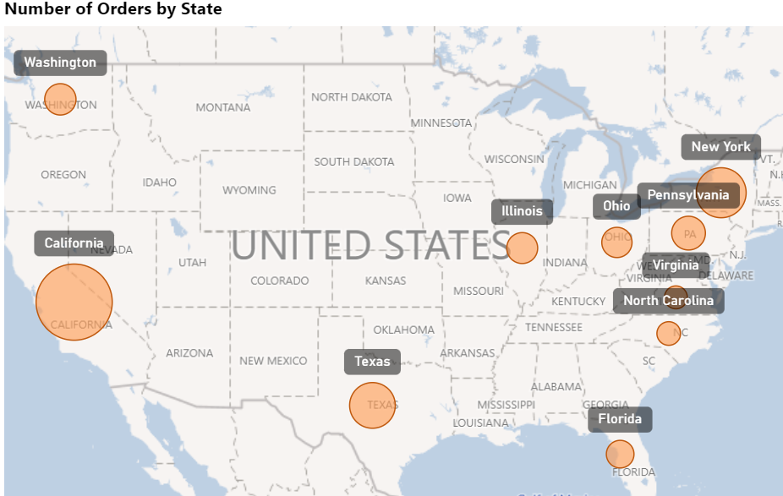
Regional analysis
California, New York and Texas are in top 3 states having the most number of orders

Slide 33
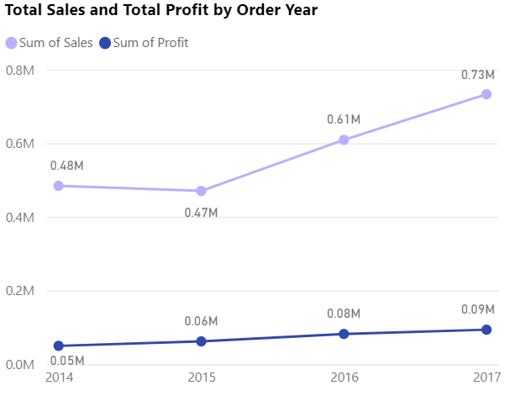
Sales trend analysis
Total profit increased steadily while total sales dropped slightly in 2015

Slide 34
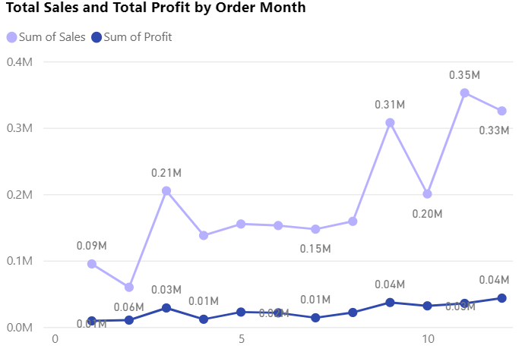
Sales trend analysis
Total sales and profit were high towards the end of the year → retail’s peak season

Slide 35
Step 4

Slide 36
Product
Insights
Recommendations
Furniture category suffered from low profit despite having high sales number and decent ordered quantity
Reducing discount rates for some products
Optimizing the cost of production
Improving delivery service

Slide 37
Product
Insights
Recommendations
The negative and low profit margin in some sub-categories
If sales are still high, re-considering pricing strategies to boost profit

Slide 38
Product
Insights
Recommendations
The ABC analysis categorizes all the products into three grades
Grade A products (selling products) should be prioritized to generate more profit to store
Grade B products should be closely monitored
Grade C products (dead products) might need to be discontinued due to the extremely low sales

Slide 39
Customers
Insights
Recommendations
Despite being the largest segment with high sales, Consumer had rather low profit and profit margin → high purchase for products in Furniture segment
Improving the profit for products in Furniture segment to boost profitability for Consumer purchasers

Slide 40
Customers
Insights
Recommendations
Pareto analysis on customers for sales and profit shows that the top 20% responsible for more than 80% of profit while the other top 20% only responsible for about half of the sales
In this case, top 20% for profit should be prioritized since they account for a large amount of profit of the company
Providing incentives and designing loyalty program to retain these customers

Slide 41
Shipping
Insights
Recommendations
Standard Class ship mode was selected for most orders and accounted for the majority of sales and profit → However, the delivery time took quite long
The average delivery time for standard class in the US is 3-5 days → trying to cut down delivery time
Offering free delivery to loyal customers
Increasing shipment fee directly or including it in product prices
(Heinig 2021; Forbes 2020)

Slide 42
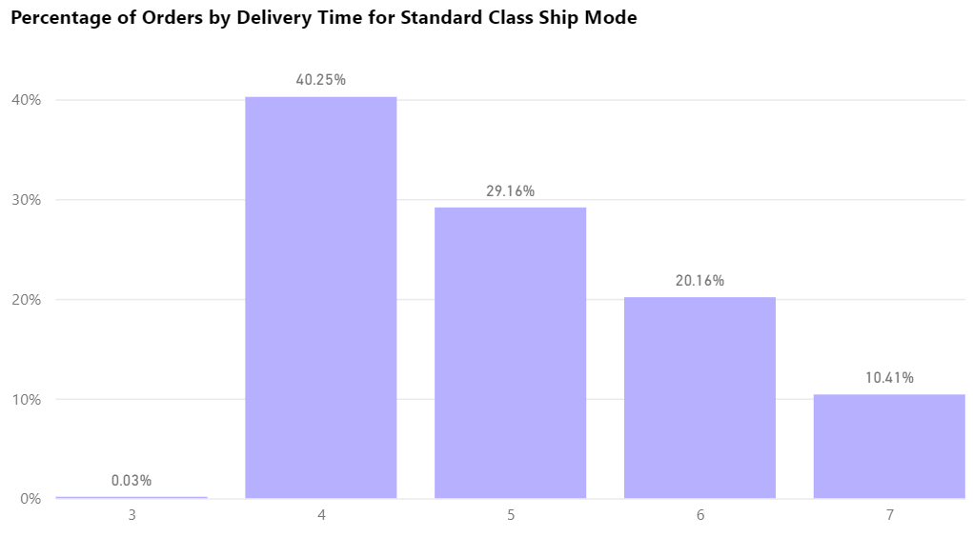
Shipping

Slide 43
Region
Insights
Recommendations
Over 50% of the store’s profit came from California and New York
Some of the states, such as Texas, incurred profit loss despite of having high sales
The store needs to carry out measures to maintain and increase sales and profit in Carlifornia and New York
Considering to stop selling products in some states (low orders, high shipping cost) to prevent costs and loss

Slide 44
Sales trend
Insights
Recommendations
Superstore’s peak season fell from September to December, in which the period’s sales and profit accounted for half the store’s total sales and profits
Preparing enough inventories to meet customers’ demand
Free delivery might be offered
Boosting advertising and marketing
(SelluSeller n.d)

Slide 45



Summary
Collecting the data
Data pre-processing → Cleaning the data
Superstore sales analysis
EDA & Visualization → Analyzing the data
Giving insights & recommendations to the findings

Slide 46
References
Arham F (2019) 'PROFIT MARGIN', accessed 3 June 2023. https://www.scribd.com/document/430966514/PROFIT-MARGIN-pdf#.
Forbes (2020) What To Consider When Choosing A Shipping Company, Forbes website, accessed 3 June 2023. https://www.forbes.com/sites/square/2020/12/10/what-to-consider-when-choosing-a-shipping-company/?sh=71060e0e3219
Heinig I (2021) What is Standard Shipping? The Full eCommerce Guide, Easyship website, accessed 3 June 2023. https://www.easyship.com/blog/what-is-standard-shipping

Slide 47
References
Kaggle (2022) Superstore Dataset [csv], Kaggle website, accessed 3 June 2023. https://www.kaggle.com/datasets/vivek468/superstore-dataset-final
SelluSeller (n.d.) How to Maximize Selling During Peak Season, SelluSeller website, accessed 3 June 2023. https://www.selluseller.com/resources/blogs/how-to-maximize-selling-during-peak-seasons
Tardi C (2023) The 80-20 Rule (aka Pareto Principle): What It Is, How It Works, Investopedia website, accessed 3 June 2023. https://www.investopedia.com/terms/1/80-20-rule.asp

Slide 48
Thank you
for listening!

